Slide 1

Natural Language Understanding and Cable News Bias
CDT Seth Benson
Advisor: MAJ Cruickshank
MA491

Slide 2
Understanding Bias
Social Science
Used ideological ideal point of individuals appearing on cable news to determine gatekeeping bias
Use qualitative image assessment to determine visual bias
Frequently leverage codebook
Usually qualitative in nature
Recent use of keyword counts and supervised learning
Data/Computer Science
Writing style bias made up of framing and word choice
Mentis networks track co-occurrences to determine syntactic relationship between words
Sentiment analysis allows for interpreting positive or negative word choice
Generally used with a single issue to infer bias

Slide 3
The Goal: More Dynamic Bias Labeling
Fills gap in literature
All current interpretations of source bias rely on inherently subjective evaluations
Meets Army Information Advantage needs
Fits my choice of data

Slide 4
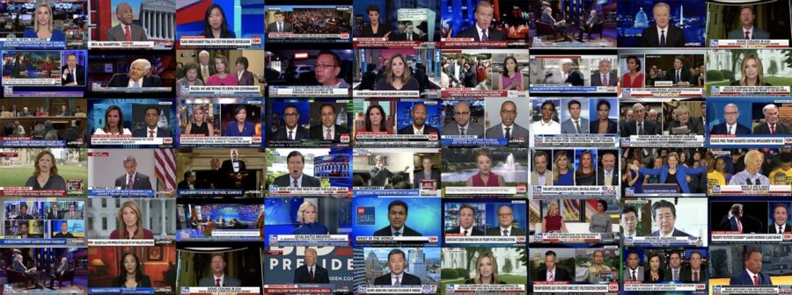
The Goal: More Dynamic Bias Labeling
Fills gap in literature
Meets Army Information Advantage needs
Fits my choice of data

Slide 5

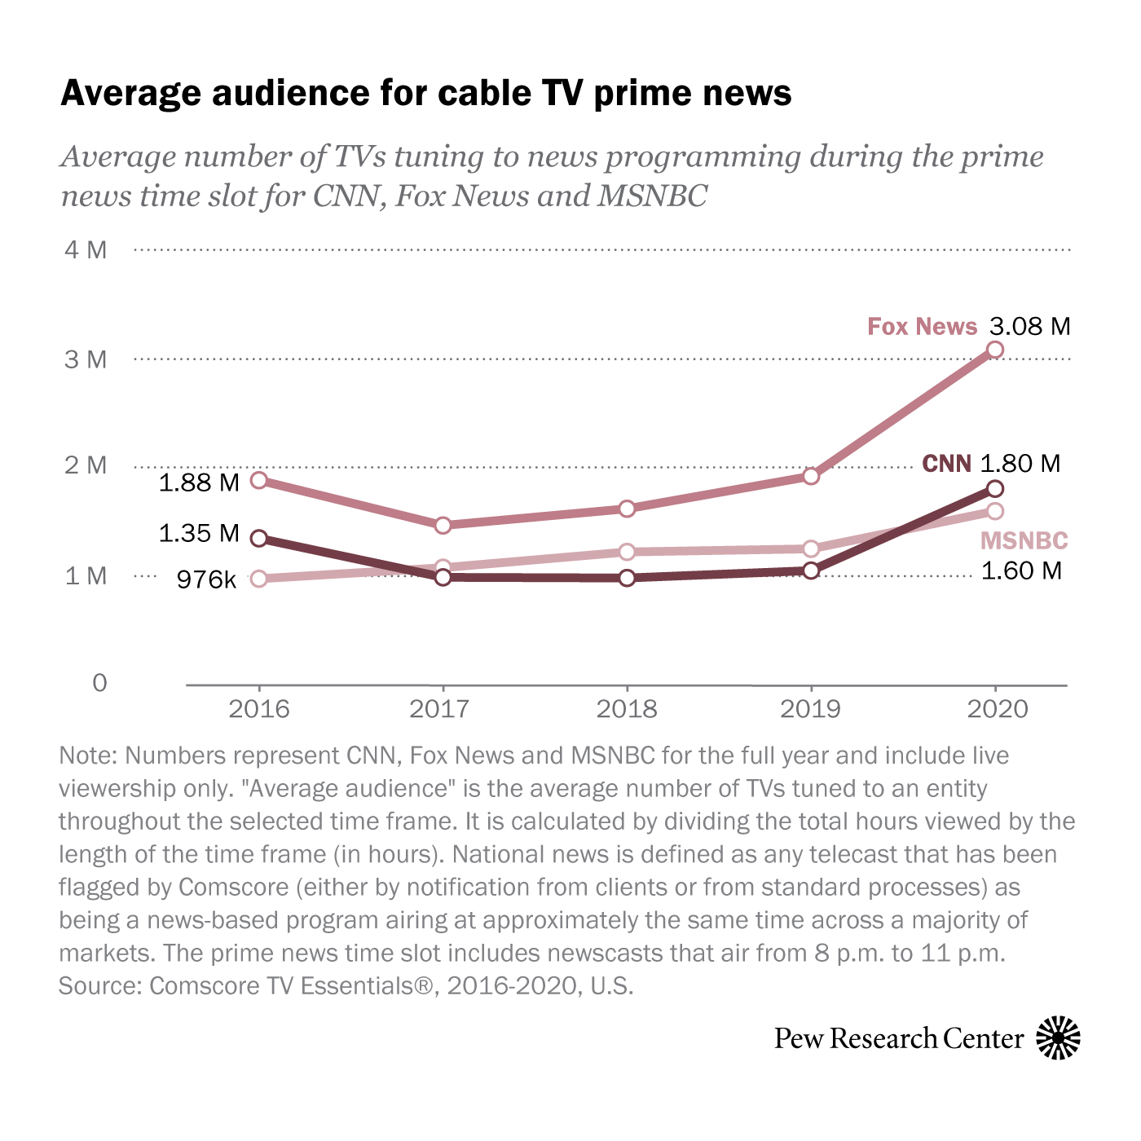
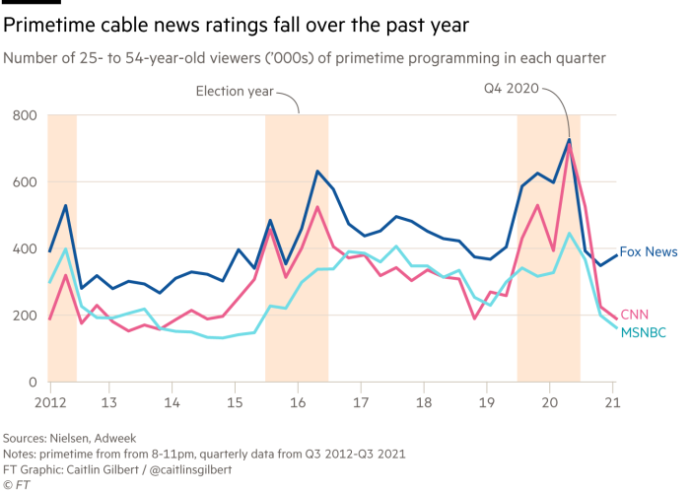
Cable News
Wide range of topics presented
Still draws large audiences
Generally biased in the opinions presented (not a platform for ideological diversity)

Slide 6
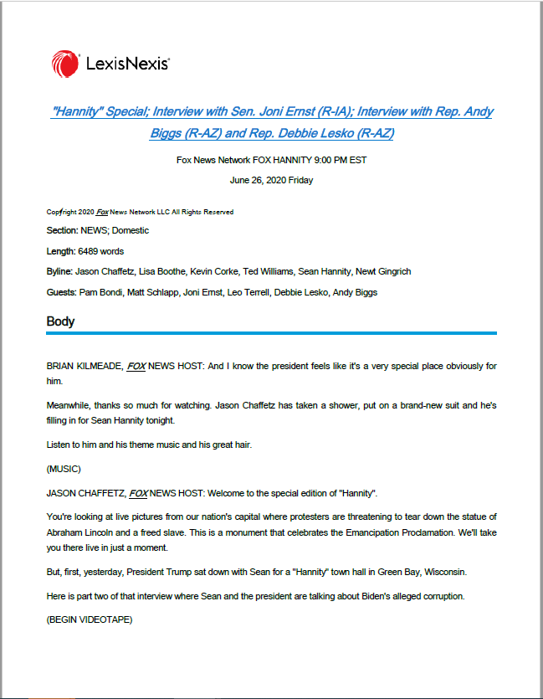
My Data
All CNN, Fox, and MSNBC news transcripts from 2009 to 2020
Metadata stored on first page
Cleaned to turn transcript into a set of statements (each assigned to a speaker)

Slide 7
Methods Overview
Transcript Level
Topic modeling
Sentiment analysis
Topic Level
Assess topic similarity
Program Level
Group topic similarity
Assign average program difference

Slide 8
Methods Overview
Transcript Analysis
VADER Sentiment Analysis
GSDMM Topic Modeling
Topic Comparison
Topic Similarity Network (sentence embedding and cosine similarity)
Program Aggregation
Transcript Sentiment/Topic Similarity Network
Program Sentiment/Topic Similarity Network and Analysis

Slide 9
Transcript Level
Use gsdmm for topic modeling
First require cleaning text: lemmanize and remove stopwords
Store top ten words for each topic, remove words used by other topics in the transcript
Use VADER for sentiment analysis
Store VADER composite polarity score for each topic

Slide 10
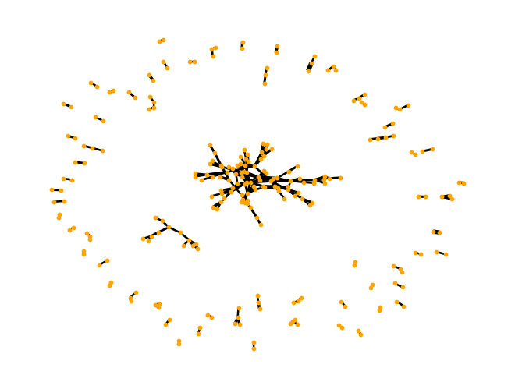
Topic Level
Create dataframe of each topic combinations
43,573,201 observations in month of January (6,601 topics squared)
Calculate similarity with Jaccard similarity scores
4,642,580 observations with a similarity > 0
Store sentiment difference

Slide 11
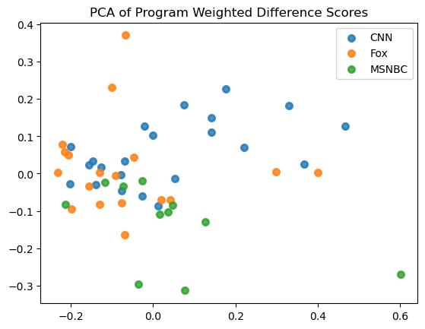
Program Level
Group topic relationships by cable news programs
Calculate average topic similarity between programs
Calculate average sentiment difference between programs weighted by topic similarity
Use dimensionality reduction to depict results
For now using PCA

Slide 12
Next Steps
Create/adopt more rigorous methods at the program level
Apply methods for comparing programs to comparing speakers
Experimental: use gpt3 for labeling topics

